Slide 1
Morphology of Stem Cells
Prof. Aranjan Karunanayake
MBBS, DM, DOH&S, Dip.Tox, Dip. Coun, D.Sp.Med, ), FSS (Ind)
MBASEM (UK), MSc.SEM (UK

Slide 2
Objectives
Student should be able to
Describe the microscopic features of erythrocyte precursors.
Describe the microscopic features of leukocytes precursors.
Describe the microscopic features of a megakaryocyte.
Describe the factors required for haemopoiesis.

Slide 3
Morphology of Stem Cells
All blood cell types are derived from pleuripotential stem cell.
Give rise to five discrete unipotential stem cells – erythrocytes, granulocytes, lymphocytes, monocytes, platelets.
These unipotential stem cells are not readily distinguishable from each other histologically. They divide and give rise to mature cell types which are distinguishable.
Rate of division – erythropoietin, interleukins, colony stimulating factors.

Slide 4
Erythrocyte precursors –
Proerythroblast – first recognisable one.
Large intensely stained granular nucleus.
Has one or more paler nucleoli.
Cytoplasm sparse. Strongly basophilic due to high content of RNA. Lacks hemoglobin.
Granulocyte precursors –
Neutrophil myelocyte, metamyelocyte, stab cell.

Slide 5
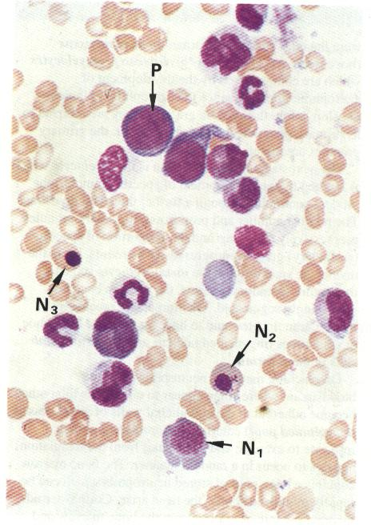

Slide 6
Neutrophil myelocyte –
Large.
Eccentrically located nucleus.
Prominent golgi apparatus.
Cytoplasm contains prominent azurophilic granules.
Metamyelocyte –
Smaller cell.
Indentation of nucleus.
Loss of prominence of azurophillic granules.
Stab cell –
highly segmented nucleus.

Slide 7
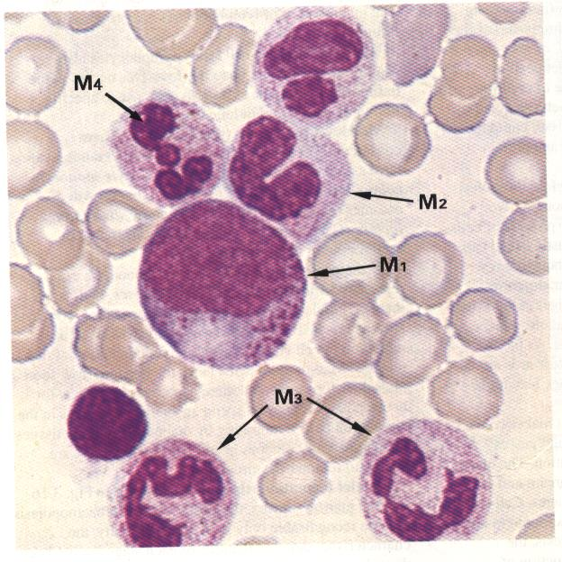

Slide 8
Megakaryocytes and platelet formation-
Large cells.
Large irregular multilobular nucleus.
No nucleoli.
Cytoplasm filled with fine basophilic granules.
Margin of cell not clear.
Cytoplasm divided into three zones-
Perinuclear – golgi, RER, SER, centrioles, spindles.
Intermediate – interconnected vesicles. Delineate developing platelet fields.
Marginal zone – outer zone, cytoskeletal filaments.

Slide 9
